Slide 1
B-SCC / SOS-SCC

Slide 2
Information for the tutor
Use of PowerPoint:
This presentation is for the courses: B-SCC and SOS-SCC;
The order of the sheets is equal to the SCC books of PBNA;
All sheets without a green top bar are intended for the above courses;
All sheets with green top bar have been added for SOS-SCC.
Online mock exam on www.vca-proefexamens.nl:
These mock exams have been developed by PBNA and are representative of the actual SCC exam;
The layout and type of questions are comparable, but they are NOT actual SCC exam questions;
After the mock exam, study advice is provided by topic.
Preparation for the exam:
During the course please announce that every candidate needs to bring a valid ID-proof with them to the exam and must also hand in a copy.
© PBNA. No part of this presentation may be reproduced or made public without the prior written permission of PBNA.

Slide 3
FOUR TOPICS
Topic A:
Prepare, discuss and inspect work
Topic B:
Performance of the work
Topic C:
Managing specific hazards
Topic D:
Managing incidents and accidents
topic
A
topic
B
topic
C
topic
D

Slide 4
Chapters
1 Regulations and Safety Rules
2 Safe working and consultation
3 Prevention
4 The workplace
5 Personal protective equipment
6 Work equipment
7 Specific working conditions
8 Hazardous substances
9 Electricity
10 Fire and explosion
11 Accidents
12 Emergency situations

Slide 5
1.1 Health and Safety (H&S)
topic
A
Occupational Health & Safety Act: health, safety and well-being at work
No adverse influence from work:
  tackle danger at source
  screening
  personal protective equipment
Where reasonably feasible:
  technical
  organisational
  economical
m

Slide 6
1.1 Health and Safety (H&S)
topic
A
Dutch Labour Inspection (NLA):
monitoring compliance with H&S legislation and Working Hours Act
measures, official report or shutting down work in case of malpractice
investigation after accidents
Obligation to immediately report serious industrial accidents!

Slide 7
1.2 Prevention and expert assistance
topic
A
Internal support for occupational health and safety issues by prevention officer
External health and safety expert (occupational health and safety service and company doctor) for:
  support in drafting RI&E and assessment
  investigations into noise, climate, physical and hazardous substances
  periodic health check
  guidance for sick employees
  medical assessments (compulsory for some positions)

Slide 8
1.3 Working Hours Act, environmental legislation and CE
topic
A
Working Hours Act: rules on working hours and rest periods
Taking into account the employee's family responsibilities
Environmental Management Act: rules for protecting people and
the environment and efficient disposal of waste
European directives: adapt national laws and regulations
to European directives

Slide 9
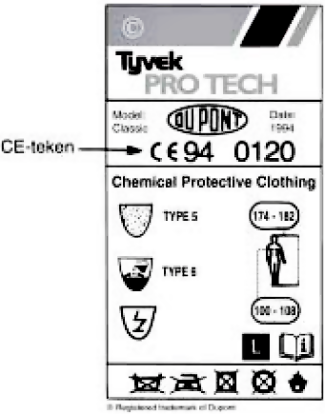
1.3 Working Hours Act, environmental legislation and CE
topic
A
CE CONTROL MARK
CE = Conformité Européene
CE = European directive for product safety
Mandatory for work equipment, work clothing, personal protective equipment etc.
Mandatory in all EU countries

Slide 10
1.4 Tasks, responsibilities & authorities
topic
A
Responsibilities of the employer:
risk inventory & evaluation (RI&E)
drawing up a plan of action
implementing policies;
investigating, reporting and registering accidents
providing training
ensure safe resources and working methods

Slide 11
1.4 Tasks, responsibilities & authorities
topic
A
Employee responsibilities:
do not cause dangerous situations
use safety guards and personal protective equipment
follow information and instructions
use tools (and machines) correctly
report hazards
cooperate in accident investigation

Slide 12
1.5 Work Permits
topic
A
Work permit:
consultation between stakeholders
binding agreements
lay down conditions for the execution of work
Specific work permits are:
hot work permits
excavation permits
working with hazardous radiation sources
asbestos removal

Slide 13
1.5 Work Permits
topic
A
Components of work permit:
request work
measures by the issuing department
measures by the holder
confirmation

Slide 14
1.6 Guidelines for general and specific safety measures
topic
A
General safety regulations:
for entire organisation
clear and unambiguous
Specific safety regulations:
supplement to general safety rules
for specific tasks and positions
Procedures:
point-by-point description of tasks and procedures
important part in safety instructions in the workplace

Slide 15
1.7 SCC and certification
topic
A
SCC** general approval
(for companies with 35 or more employees and main contractors)
SCC* limited approval
(for companies with fewer than 35 employees)
SCC petrochemical additional requirements to SCC**
(for companies that perform high-risk activities in the petrochemical industry)
SCE approval for secondment and employment agencies
SCP for clients of SCC/SCE certified companies

Slide 16
1.8 Duties and responsibilities of the hirer and temporary employment agency
topic
A
  Hirer:
  Responsibilities
  Information provision
  Risk inventory
  Transit obligation:
  Instruction and information
  Points for attention when applying for a hirer
  Points of attention during selection
  Temporary worker file:
  What should be in the file
  Evaluation:
  With hirer
  With temp

Slide 17
2.1 Safe working and conduct
topic
A
Safe conduct is:
Behaving in a way that does not endanger yourself and others
You achieve this by:
observing the safety regulations
following directions and instructions
stopping unsafe actions
eliminating unsafe situations
unsafe behaviour: approaching the person or reporting to a manager
maintaining order and tidiness

Slide 18
2.2 Consultation and training
topic
A
Training and instruction:
introduction of new employees
start work, kick off meeting
toolbox meeting: short meeting about safety in an informal atmosphere
HSE Meeting
consultation with employees
motivating employees
Points of attention for a good HSE meeting:
clearly documented agreements
check whether agreements are understood

Slide 19
2.3 Workplace inspection and observation rounds
topic
A
Safety Observation Round:
by managers (objective)
focused on:
  unsafe actions
  unsafe situations
raising safety awareness of the group
supervisors come to the workplace
gaining insight into the workplace and employees
Make an annual plan for observation rounds and workplace inspections

Slide 20
2.4 Promoting safe behavior of temporary workers
topic
A
Working safely and mentality of the temporary worker
With regard to working safely
With regard to mindset
Transit obligation
The above information is often recorded in a so-called Health & Safety document or H&S document. This contains relevant matters about working conditions.

Slide 21
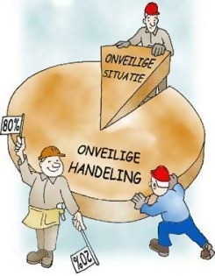
3.1 Hazards and risks
topic
A
Sources of danger:
type of work
knowledge and experience
the workplace
wellbeing
Mentality
Limiting risks by preventing:
unsafe actions
unsafe situations RISK = CHANCE x EFFECT

Slide 22
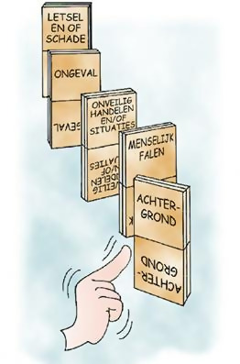
3.2 Accident prevention
topic
A
Prevent accidents/incidents by:
Preventing unsafe actions
Prevention of unsafe situations
Measures:
task or description of work
supervision, instruction and training
Preventive safety policy: technology, organisation,
people and environment

Slide 23
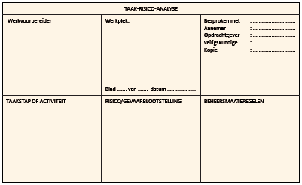
3.3 TRA and LMRA
topic
A
Task Risk Analysis → RI&E at project level
  when performing hazardous tasks or working in a hazardous environment:
  start work preparation
  hazard analysis
  assess actions

Slide 24
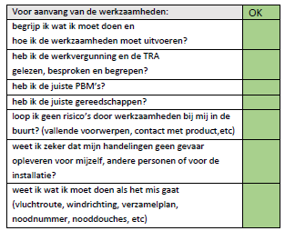
3.3 TRA and LMRA
topic
A
An LMRA or Start Work Analysis:
before you start the work
short risk assessment and "self assessment"
think first, act later

Slide 25
3.4 Prevention and the role of the manager
topic
A
Role of manager important for safety:
supervision, workplace inspections and safety rounds
organising consultation, instruction and training
Promoting safety through good motivation:
Judge objectively and give your opinion to that person
Show respect for a person and their skill when correcting someone
Don't just say how but also why
Manager has an exemplary position

Slide 26
3.5 RI&E, H&S annual plan and action plan
topic
A
Risk Inventory and Evaluation (RI&E)
mandatory for all companies with (hired) staff
inventory of hazards at work and the chance of negative effects
active role of manager in drafting RI&E
Evaluation and plan of action (annual H&S plan)
  concrete preventive measures
  resources (organisational, financial)
  responsible persons and time frame for implementation
  RI&E and annual H&S plan: adjust regularly

Slide 27
4.1 Risks in the working environment
topic
B
Risk of:
falling
slipping
tripping
poor lighting
noise pollution (>80dB(A))
Safe work environment through:
good workplace setup
good housekeeping
good lighting

Slide 28
4.1 Risks in the working environment
topic
B
Comfortable climate is determined by:
  clothing
  exertion
  humidity (relative humidity 40-60%)
  temperature
  air velocity
Measures to improve working comfort are:
  maintaining a comfortable temperature
  equally adapted to physical exertion
  no intrusive air movement
  maintaining the humidity in the room
  PPE

Slide 29
4.1 Risks in the working environment
topic
B
Environment Factors:
climate
light (artificial light, daylight)
sound
vibrations
dimensions of workspace
ventilation
decor and furniture
Prevention: programmes for time management, dealing with work pressure, preventing sick leave

Slide 30
4.2 Risks of physical strain
topic
B
Safe lifting:
no more than 23 kg
use good PPE: safety shoes, gloves
use lifting aids
lift with two people
Safe lifting:
make a lifting plan
correct posture, varied posture
determine your own pace
regularly take short breaks

Slide 31
4.2 Physical strain
topic
B
Vibration:
avoid prolonged and regular exposure
use vibration damping materials or insulation
PPE: vibration-damping gloves
regularly take short breaks

Slide 32
4.2 Physical strain
topic
B
Sitting for long periods is a burden due to static strain
Alternation prevents complaints:
walking/tanding/sitting/different sitting positions
Optimal sitting position:
  legs well supported
  good back position
  relieving shoulders
  possibility of adopting other positions

Slide 33
4.3 Securing the workplace and installation
topic
B
Secure work environment:
check prior to work
by authorised person
safety measures to the work permit
do not remove any safeguards or locks
Securing process management / installation
use connecting flange for disconnecting pipes
never stand under the pipe during (dis)assembly
regularly check for any leaks

Slide 34
4.4 Safety signs in the workplace
topic
B
Signs:
Prohibited
Mandatory
Warning
Safety provisions
Marking and stripes:
marking of hazards in the workplace
walkways, passages
Ribbon:
marking dangerous situation
do not use as a physical cordon

Slide 35
5.1 Personal protection
topic
B
Personal protective equipment:
made available by the employer
compulsory if work or workplace requires this
Requirements and use:
user manual in Dutch
CE control mark required
use correctly and check regularly
maintenance and cleaning according to instruction
store safely and carefully

Slide 36
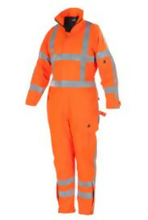
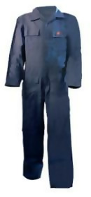


5.1 Personal protection
topic
B
Physical protection:
overalls
flame retardant clothing
high visibility clothing
all-weather clothing
antistatic clothing

Slide 37



5.2 PPE for head, hands and feet
topic
B
Head protection
Hand protection
Toe protection:
Protection: S1, S2, S3

Slide 38
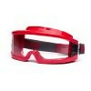

5.3 Eye protection
topic
B
safety glasses
safety goggles
face shield
Specific eye protection:
welding goggles
welding shield

Slide 39

5.4 Hearing protection
topic
B
earwadding 10 dB(A)
earplugs 10-15 dB (A)
earplugs 10-15 dB (A)
earmuffs 25 dB (A)
otoplastics 25 dB (A)

Slide 40
5.5 Fall protection
topic
B
Safety harnas
Line with line clamp
Fall arrest

Slide 41

5.6 Breathing apparatus
topic
B
Respiratory protection:
dust mask
half-face filter mask
full-face filter mask
Self-contained breathing apparatus:

Slide 42
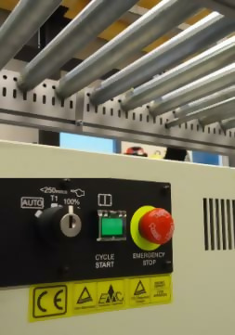
6.1 Working with stationary machines (1)
topic
B
Machine tools:
CE control mark
inspection electrical installation parts: NEN 3140
shield sharp and rotating parts
emergency stop
operating and maintenance manual
instruction card
pictograms: warning risks
PPE to wear
Under 18? Only work under supervision!

Slide 43
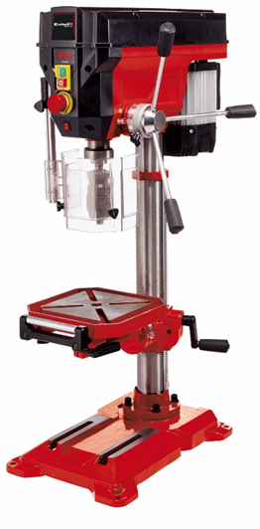
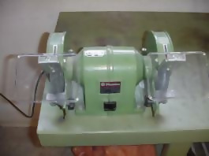
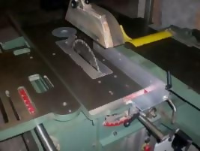
6.2 Working with stationary machines (2)
topic
B
column drill grinding machine circular saw

Slide 44



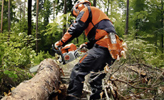
6.3 Hand-held power tools
topic
B
Hand-held grinder:
protective cover, side handle and the right disc
PPE: safety glasses
Hand-held circular saw:
riving knife and automatic protective cover
only use tight-fitting gloves!!
Chainsaw
>18 years and trained>
PPE: saw pants, saw helmet with ear muffs
boots with saw protection
tight-fitting gloves with saw protection

Slide 45


6.4 Working with hand tools
topic
B
use suitable tools
use tools for what they are intended
repair or replace damaged tools

Slide 46
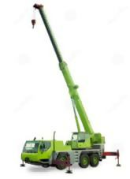
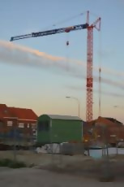
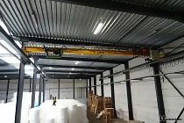
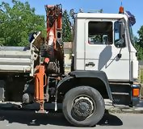
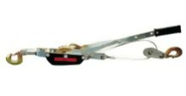
6.5 Working with hoisting equipment
topic
B
Different types of hoists:
inspection documents and CE marking
hoisting tables and charts
operator training
Manual hoist: also for horizontal movement

Slide 47
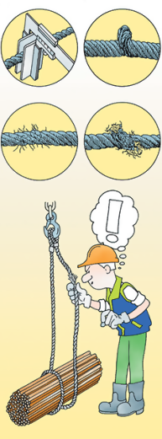
6.6 Working with hoisting accessories and manual hoists
topic
B
do not use damaged chains or steel cables
do not carry out repairs yourself
hoisting accessories must be inspected
approved materials are labeled

Slide 48
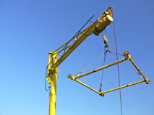
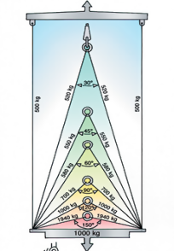
6.6 Working with hoisting accessories and manual hoists
topic
B
Special hoisting accessories:
assembly with two, three or four slings
hoisting yoke
Hoisting with an assembly:
spreading angle maximum 120° (legal)
safe lifting angle: 90°

Slide 49
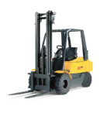
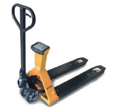
6.7 Forklift trucks and pallet trucks
topic
B
Working safely with a forklift:
stably loaded on both forks
driver at least 18 years old
wearing a seat belt is mandatory
Working safely with a pallet truck:
Remember to adopt a correct working posture
not to heavily loaded or overloaded
good visibility and sufficient manoeuvering space

Slide 50

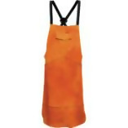
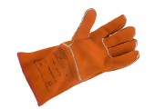
7.1 Welding, burning and cutting
topic
B
screen the workplace properly
ensure adequate extraction and ventilation
use the correct PPE

Slide 51
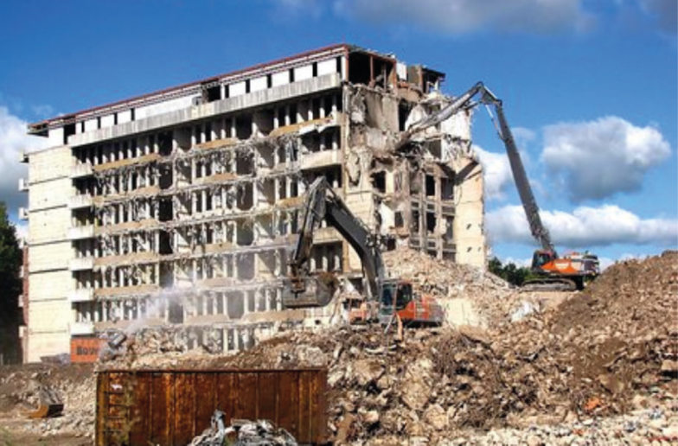
7.2 Demolition work
topic
B
Risks:
falling and tripping
being hit by rubble
hearing damage due to noise
hazardous substances (asbestos, quartz dust)
Wear PPE, at least:
safety helmet, overalls, safety shoes
for manual demolition work: safety glasses/safety goggles
respiratory protection: dust filter or filter cartridge mask

Slide 52
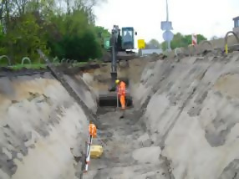
7.3 Excavation work
topic
B
Safety during excavation work:
KLIC message and manual pre-digging
safe slope, sufficient support struts
no gas bottles in deep trench
measures to prevent falling into the trench
Digging in contaminated soil: extra measures

Slide 53
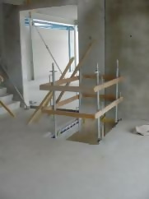
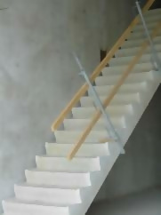
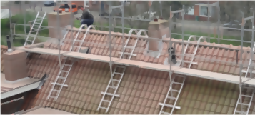
7.4 Working at height
topic
B
Safety measures from 2.5 metres:
workfloors
cordon off openings with fencing and railings
close floor openings if possible
use roof edge protection when working on roofs
PPE: safety harness
Working on roofs: pay attention to weather conditions!

Slide 54
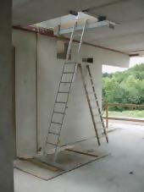
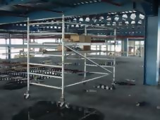
7.5 Materials for working at height (1)
topic
B
Points to consider when working with ladders:
keep in good condition
do not paint
do not repair yourself
set up carefully and properly
use it properly
Points to consider when working with mobile scaffolding tower:
block wheels
climb from the inside
do not move if someone is on it
move on flat surface with 2 people

Slide 55
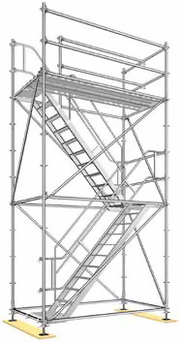
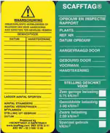
7.5 Materials for working at height (2)
topic
B
strictly prohibited to (re)build scaffolding yourself
do not leave any material behind
do not use loose climbing equipment on the
scaffold.
pay attention to the maximum load
use chutes for waste material
use the construction lift safely (passenger lift or
goods lift)
Scaffolding card indicates safety status.
No scaffolding card or defects? Do not use the scaffolding!

Slide 56
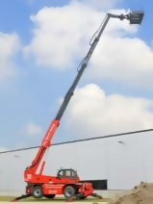
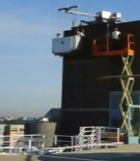
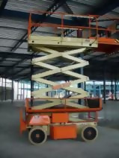
7.5 Materials for working at height (3)
topic
B
Working safely with cherry pickers and suspended scaffolding:
only if you have had training
discontinue use in the event of a fault
but repair
never leave ready for use
hazardous environment? Supervision on the ground!
Use of aids or communication:
mandatory from 25 m
if normal communication is not possible
PPE: safety harness with fall line

Slide 57
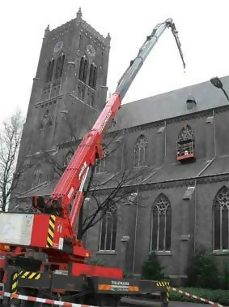
7.5 Materials for working at height (4)
topic
B
Working safely with a safety cage:
use only when there is absolutely no alternative, use prohibited from wind force 7 Bft
the crane operator and person in the safety cage
must be able to see and understand each other (walkie-talkie)
every person in the safety cage wears an individual safety harness (attached to the safety cage)
boarding or exiting is only permitted if the cage is on a solid surface
Working at height in (suspended) scaffolding and aerial work platforms is not allowed:
in the event of a thunderstorm
In bad weather conditions

Slide 58
7.6 Confined spaces (1)
topic
B
Risks of confined spaces:
fire and explosion
presence of hazardous substances
oxygen deficiency
electrocution
falling and tripping

Slide 59
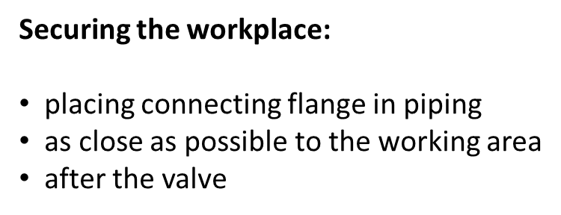
7.6 Confined spaces (2)
topic
B
Working in confined spaces:
work permit
measurements before entering
use the right tools
safe voltage (50V~ or 110 V=)
warning signs at the entrance
emergency procedure
supervision: security guard, manhole attendant
PPE: at least overalls, safety shoes
Industry: safety helmet and safety glasses
Sometimes respiratory protection is required.

Slide 60










8.1 Risks and safety measures
topic
B
On the label:
(chemical) name of the substance
hazard symbol / icon
H-statements
P-statements
name manufacturer/supplier
With or on the packaging: user instructions in Dutch

Slide 61
8.1 Hazard diamond
topic
C
fire hazard
2
health
hazard
1
0
reactivity
instability
w
specific terms

Slide 62
8.2 Exposure to hazardous substances
topic
C
Intake/ingestion through:
digestion
respiration
skin
Preventative measures for exposure:
tackle the source
ventilation
separate man and source
PPE

Slide 63
8.3 Threshold limit values and perception of odour
topic
C
Poisoning:
acute
chronic
Limit value:
8 hours/day, 40 hours/week
adult, healthy person
normal working conditions
Odour threshold: not a good indication!

Slide 64
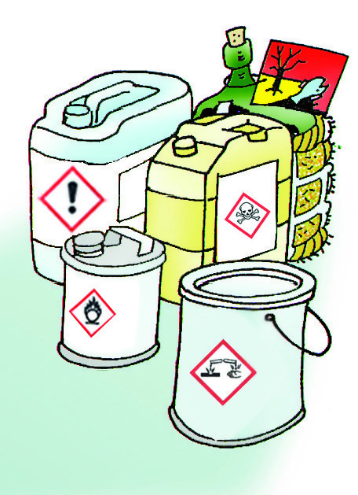
8.4 Common hazardous substances
topic
C
Types:
(Organic) solvents
Cyclic compounds
Acids and alkalis
Heavy metals
Carbon monoxide
Asbestos
Cement
Household chemicals

Slide 65

8.4 Asbestos
topic
C
Processing asbestos is prohibited
Professional handling of asbestos only:
  upon demolition/removal
  maintenance/repair
  exemption
  Expert Supervisor (DTA) present
Suspicion of asbestos-containing material?
  suspend work
  have a sample taken by an independent laboratory
  removal by a professional company only
  KOMO process certificate for asbestos removal for contractors
  train asbestos removal employees according to written plan

Slide 66
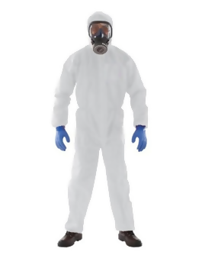
8.5 Biological substances
topic
C
Risks with exposure:
infections
poisoning
allergy
moulds
When?
in contact with animals
working in sewers
working in contaminated soil or waste processing
working in certain departments of hospitals and nursing homes

Slide 67
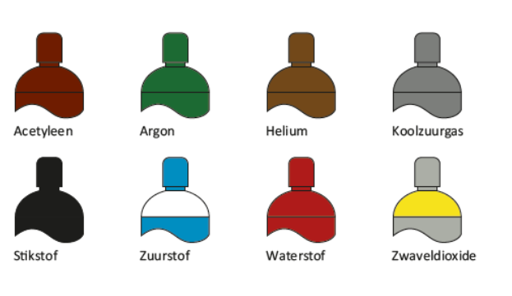
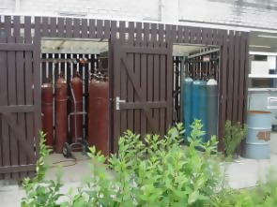
8.6 Industrial gas cylinders
topic
C
Points of attention:
Colour coding on cylinder shoulder
Store correctly
Sufficient ventilation of storage space
Never store in or near basements, pits and trenches
Keep oxygen bottles separate from flammable gas bottles
Suitable extinguishing agents
Water as a coolant for storage

Slide 68
8.7 Supervision by the manager
topic
C
Toxicology = the doctrine of the effects of harmful substances on living things
Toxicity = poisonous property of a substance
toxic to all living organisms
individual sensitivity
Measures to limit risks:
  at the source;
  technical and organisational measures

Slide 69
8.7 Supervision by the manager
topic
C
The manager makes and keeps the employee aware of:
  the dangers
  importance of hygiene
  preventing risks
Additional supervision of:
  correct application and use of hazardous substances
  proper use of PPE
  order and tidiness
  cleaning tools and other resources
  waste disposal

Slide 70
9.1 Electricity, hazards and risks
topic
C
Accidents:
resistance smaller → current greater → heat development greater
The size and nature of the injury depends on:
  route of the current through the body
  contact area
  current
  duration current flow
  type and amount of voltage
  physical fitness

Slide 71

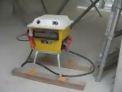
9.2 Working safely with electricity
topic
C
Use double insulated tools
Ensure installations and tools have been tested (NEN3140)
Actions by experts only:
  No expertise? DO NOT TOUCH!
With building current connection: mains circuit breaker in electrical supply (response value 30 mA)
Grounding of metal workshop and storage containers
Grounding steel scaffolding
Safe voltage: max. 110 V DC (=) or
max. 50 V alternating voltage (~)

Slide 72
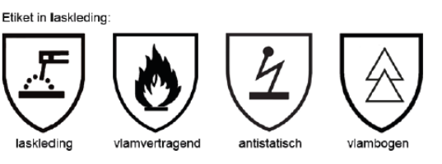
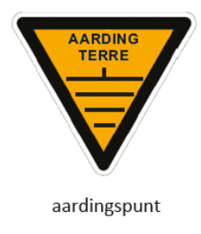

9.3 Special hazards with electricity
topic
C
Static electricity, safety measures:
add antistatic dope (ASA)
limit flow rate
limit the fall height of product in storage tank
good grounding of pipes, equipment, tanks
ground the high pressure sprayer
applying inert gas (forexample nitrogen)
connect to grounding network
increase humidity with dry dust
always wear anti-static PPE

Slide 73
9.4 Radiation
topic
C
Ionising radiation:
  enough energy to change irradiated material
  depending on strength, dose and exposure harmful to humans and the environment
For example: medicine, nuclear power plants,
measuring/detection equipment, natural gas extraction and ore processing
Non-ionising radiation:
  does not affect material structure
  high dose / long-term exposure is harmful (injury)
For example, sunlight, ultraviolet/infrared radiation, laser rays, radio
or microwaves

Slide 74
9.4 Radiation
topic
C
Safety measures when working with radiation are:
  keeping distance; distance 4x greater → radiation dose 16x smaller
  do not damage the packaging of materials
  cordon off area around source, place warning signs
  Use PPE
  continuous monitoring
  radiation expert present
Employees are required to:
  have the personal dose of radiation measured
  accurately follow all regulations
  to undergo a medical examination

Slide 75

10.1 Fire and explosion
topic
C
Fire: combustible substance + oxygen + ignition
Explosion: a lot of damage due to pressure wave
Smoke: restricted view
harmful substances and gases
Heat: risk of serious injury (skin, respiratory tract)
Extra fire hazard: oxygen >21%>

Slide 76
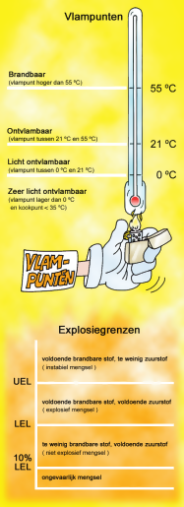


10.2 Fire and explosive atmosphere
topic
C
Flash point:
temperature at which vapour can ignite from liquid
Explosion: very fast fire with pressure wave
Explosion area: between explosion limit LEL and UEL
Working in explosive atmospheres:
use explosion-proof tools only
wear antistatic clothing

Slide 77
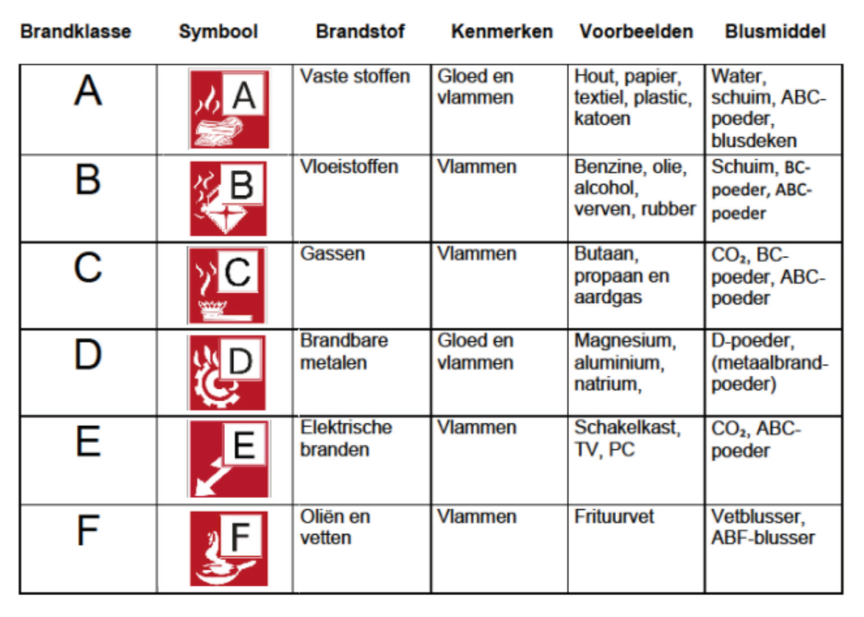
10.3 Fire classes and extinguishing agents
topic
C

Slide 78

10.4 What to do in the event of a fire?
topic
C
Upon discovering a fire:
personal safety first!
report the fire (112 or internal emergency number)
warn others in the vicinity
close windows and doors
follow the indicated escape route
Only extinguish if it is possible!
In the event of an alarm:
turn off ignition sources
leave the room / area
report at the assembly point

Slide 79

10.5 Explosive atmosphere
topic
C
In potentially explosive atmospheres, it is strictly forbidden to:
enter without permission
to take materials and resources that could pose a hazard without permission
perform work without a work permit
During work firefighter or hot work attendent present
Zone indication:
gas/vapour: zone 0, 1 or 2
substance: zone 20, 21 or 22

Slide 80
11.1 What to do in the event of an incident?
topic
D
An accident is undesirable and results in damage and/or
injury
A near-accident is undesirable but does not result in
damage and/or injury
Report these incidents to the manager
Proper report:
name
location
nature of incident
number of victims and injuries

Slide 81
11.2 Accident investigation and registration
topic
D
Registration of:
accidents and near-accidents
environmental incidents
fire and explosion
Registration is important:
recording data according to health and safety policy
meeting legal requirements and SCC requirements
measures to prevent accidents

Slide 82
11.2 Accident investigation and registration
topic
D
Objectives of accident investigation:
which factors were the cause of the accident?
aimed at preventing accidents
Components of accident investigation:
accident investigation at the location of the accident
keep evidence
interviewing witnesses/persons involved
analysis research findings
final report (conclusions/recommendations)

Slide 83

12.1 Emergency situations
topic
D
Contents company emergency plan
Measures and provisions to limit and combat the effects of a disaster
Based on estimated calamities or incidents (i.e. RI&E)
Employees and visitors must be aware of:
  emergency procedure
  evacuation areas

Slide 84
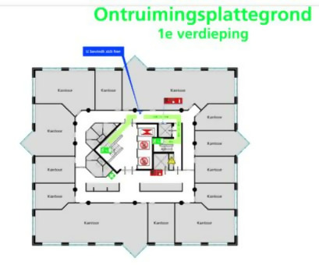
12.1 Emergency situations
topic
D
The company emergency plan includes:
  (eviction)map
  Description of location safety equipment
  Alert procedure internal/external emergency services
  Instruction and information about:
- types of alarms
- what to do in case of fire/eviction
- first aid
- (evacuation) exercises
- reporting incidents/situations
- preventions and measures

Slide 85

12.1 Emergency situations
topic
D
Phasing:
first alarm/response
announce the classification of the incident
actions/measures:
  stop working, do not use the telephone
  switch off equipment
  go to assembly point and report to coordinator
  safeguard end of incident and evidence of the cause of the incident

Slide 86
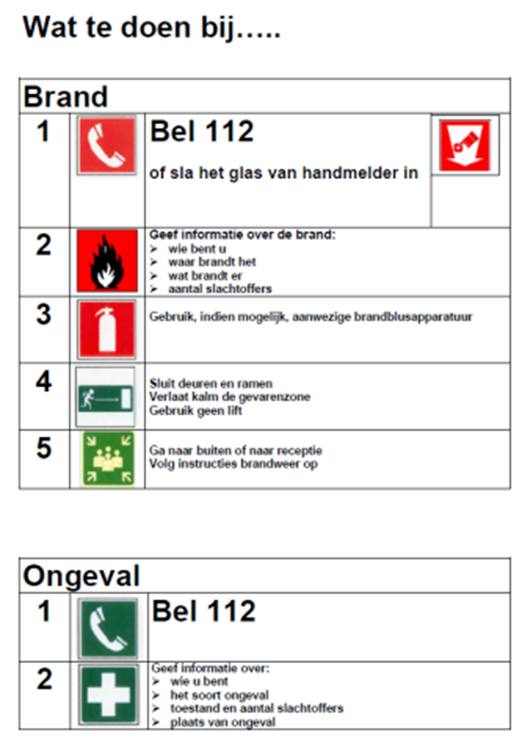
12.1 Emergency situations
topic
D
Emergency phases:
report
act and take measures
safeguard the situation
end emergency
At the assembly point:
do not leave the assembly point
wait for CER instructions
For research:
do not change anything at the location of the accident

Slide 87

12.2 Company Emergency Response (CER)
topic
D
Occupational Health and Safety obligation:
sufficient company emergency responders in every company or
arrange company emergency responders fe.with neighbouring companies
company emergency response is partly determined based on RI&E
requirements for company emergency responders expertise
evacuation drill at least once a year

Slide 88
12.2 Company Emergency Response (CER)
topic
D
The following applies to in-house emergency services:
  must be arranged and guaranteed in every organisation
  Company Emergency Responders must be adequately trained
  there is a set of tasks
  establish warning and alert procedures
Tasks of the CER are:
  provide first aid
  fight incipient fires
  evacuation
  communication with emergency services
  prevention

Slide 89
12.2 Company Emergency Response (CER)
topic
D
Education, practice and training:
necessary for testing the emergency response plan
to prepare employees and company emergency responders for incidents
practice/repetition of company emergency plan:
  internal
  in combination with emergency services
An evacuation exercise at least once a year!

Slide 90
Exam: B-SCC / SOS-SCC / SIS-SCE
Exam
Types of questions:
multiple choice
multiple answer question
matrix question
ranking question
matching question
 | B-SCC | VOL - SCC | SIS-SCE
Number of questions | 40 | 70 | 70
Max. number of points | 4000 | 7000 | 7000
Pass mark (number of points to pass) | 2600 | 4500 | 4500
Time | 60 minutes | 75 minutes | 75 minutes

Slide 91

Exam: multiple choice question
(Point count: True 100-point score/ False 0-point score)
Exam

Slide 92


Exam: multiple answer question
(Point count: Best possible 100-point score/ Points reduction per incorrect answer)
Exam

Slide 93

Exam: matrix question (Point count: Best possible 100-point score/ Points reduction per incorrect answer)
Exam

Slide 94

Exam: ranking question (Point count: True 100-point score/ False 0-point score)
Exam

Slide 95

Exam: matching question (Point count: True 100-point score/ False 0-point score)
Exam

Slide 96
Exam tips
Exam
Make sure you are on time for the exam.
Always bring valid proof of ID.
Telephones may NOT be present in the exam room.
Read all questions and answers carefully. Unfortunately, quite a few mistakes are made because candidates do not read properly.
Answer all questions, an unanswered question is always incorrect.
For some questions you have to select several answers.
Good luck with your exam

